Slide 1

Project: Healthcare - Persistency of a drug
Submitted by: Chenyu Wang
Specialization: Data Science
Batch code: LISUM 13:30
Date: 30-Nov-2022

Slide 2
Agenda
Problem description
Project lifecycle
Data Report
Data Understanding & Cleaning
Model Development
Evaluation
Conclusion

Slide 3
Problem description
One of the challenges for all Pharmaceutical companies is to understand the persistency of drug as per the physician prescription. To solve this problem ABC pharma company approached an analytics company to automate this process of identification.
With an objective to gather insights on the factors that are impacting the persistency, build a classification for the given dataset.

Slide 4
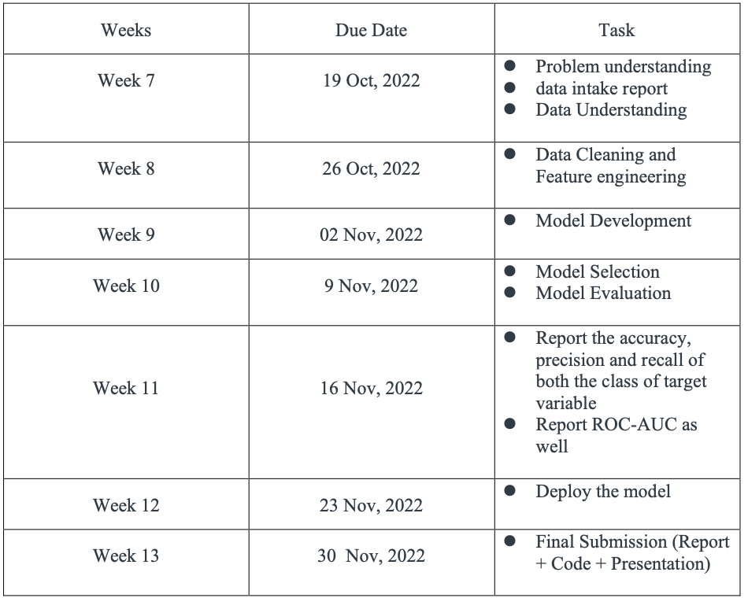
Project lifecycle

Slide 5
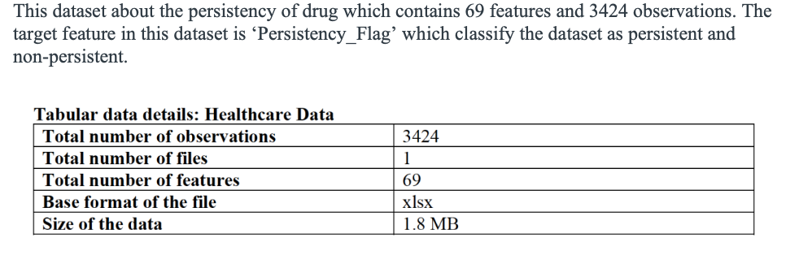
Data Report

Slide 6
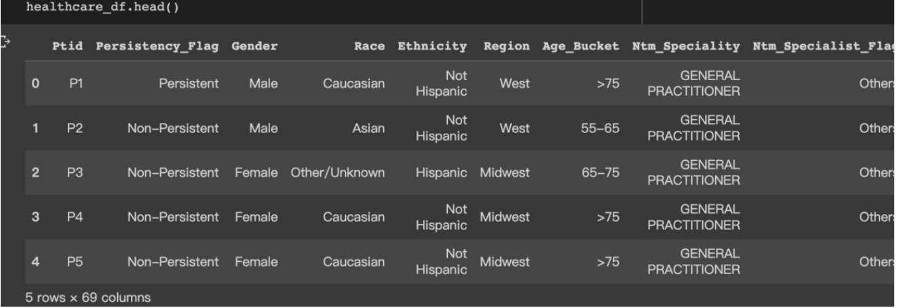
Data Understanding & Cleaning
There are not missing value and duplicate value.
67 features are categorical values.
I used label encoder covert them to numerical values.
The dataset is imbalanced.
I used SMOTE technology to deal with this problem.
There are outliers in feature ‘count_of_risks’
and ‘Dexa_freq_during_Rx’. I used Quantile Transformer
transforms the features to follow a uniform or a normal
distribution.

Slide 7
Model Development Decision Tree
I built the Decision Tree model.
a 10-fold cross-validation method.
According to the result of Grid Search, max_depth as 7 and min_samples_leaf as 20 to build decision tree model.

Slide 8
Model Development LightGBM
I built a LightGBM model.
10-fold cross-validation method.
According to the result of Grid Search, n_estimators as 40 and num_leaves as 31 to build LightGBM model.

Slide 9
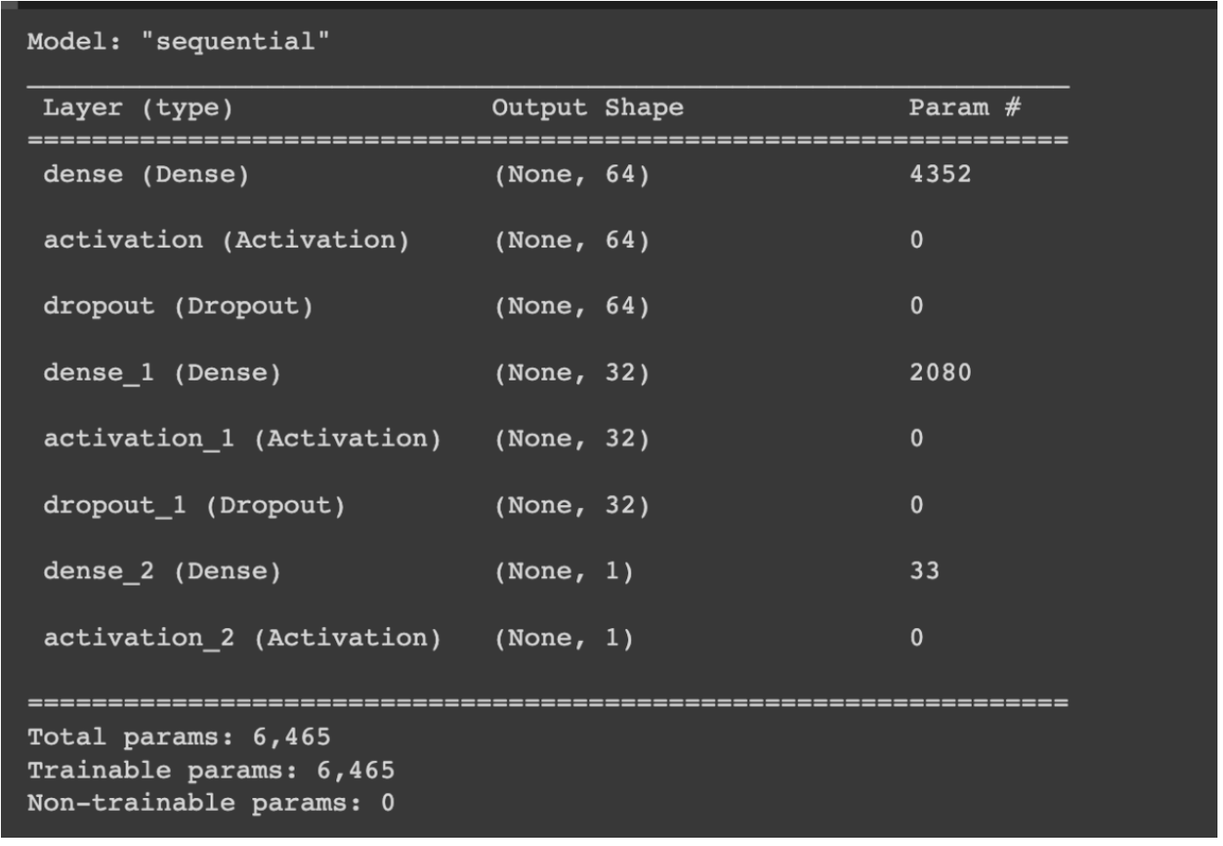
Model Development DNN

Slide 10
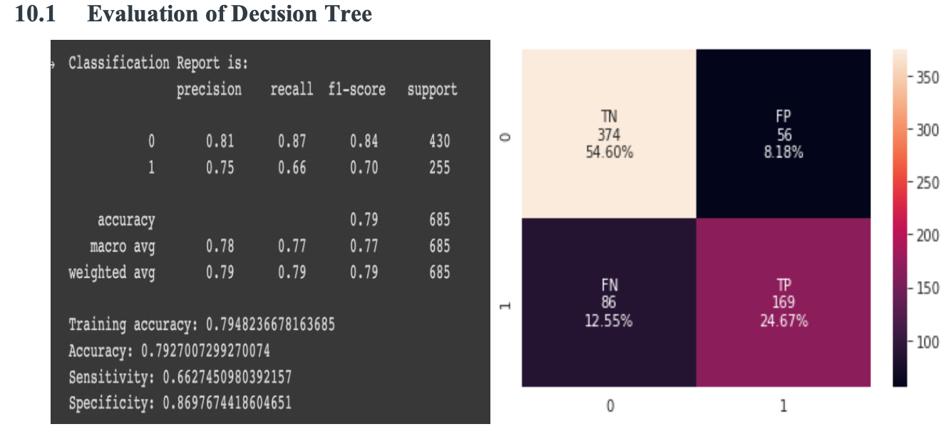
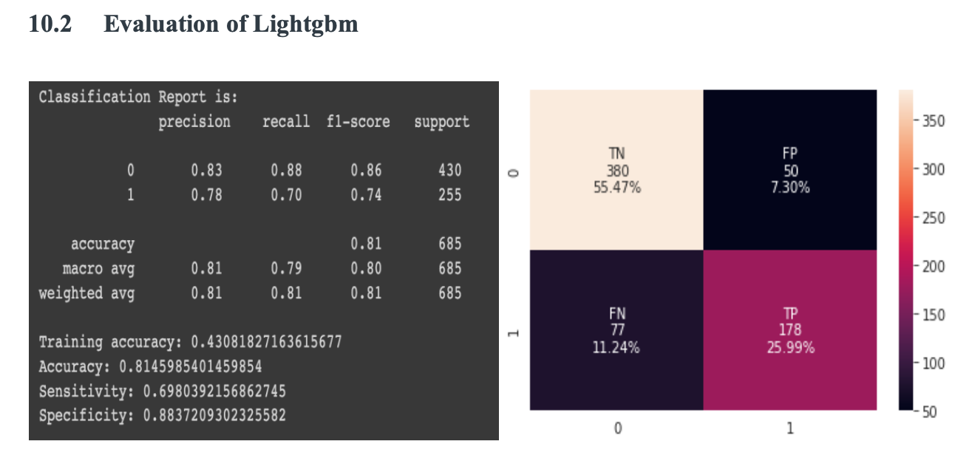
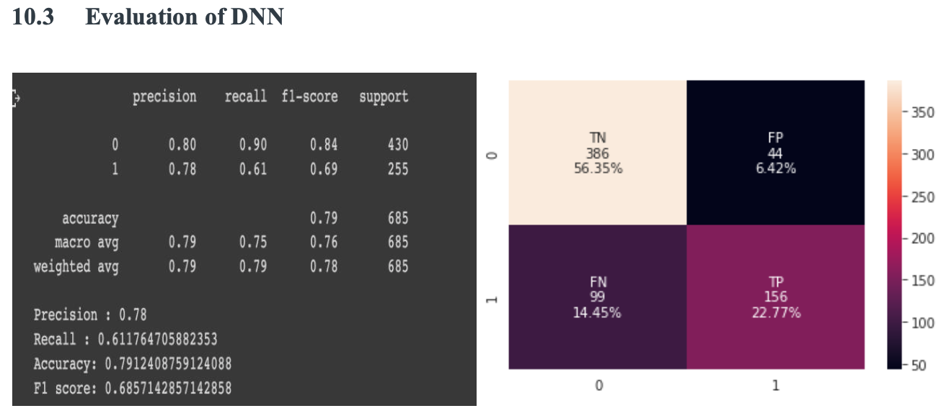
Evaluation

Slide 11
Conclusion
In this project, I analysis the persistency of drug. Decision tree, Lightgbm, and DNN models were built to classify the persistency of drug.
Based on evaluation, Lightgbm is the champion model. The accuracy of Lightgbm is the highest one with 0.81. In the future, the Lightgbm will deploy to automatically identify persistency of drug.

Slide 12
Project: Healthcare - Persistency of a drug
Thank You

